Slide 1
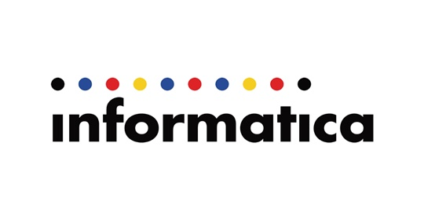
INFORMATICA CLOUD
Importance and features

Slide 2
Introduction
According to Gartner, Cloud computing is #1 Strategic Technology
It has many Business Applications
Informatica cloud works on many different platforms
IT Infrastructure is maintained such as Lower costs, Accelerate Projects and Elastic Capacity

Slide 3
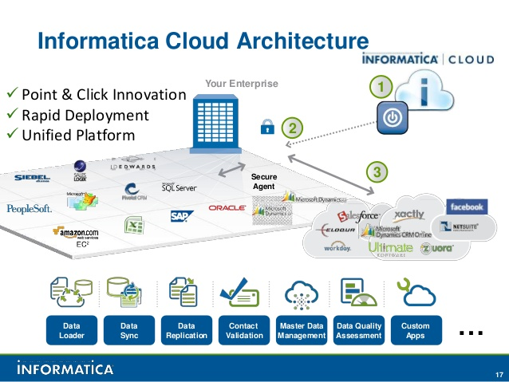
Architecture

Slide 4
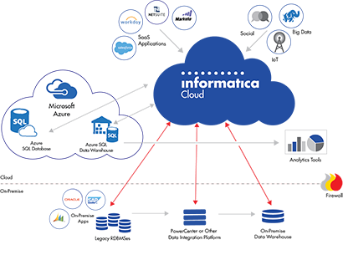
WITHOUT Data Integration , Cloud-based systems wont provide the value you are seeking.

Slide 5
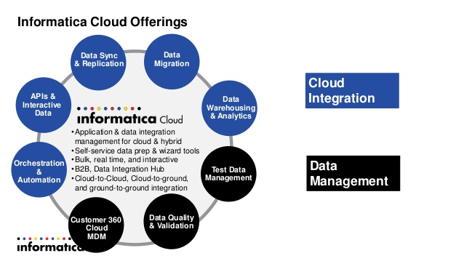

Slide 6
Informatica Cloud Features
Data Migration
Data Synchronization
Data Monitoring
Data Replication
Data Warehousing and Analytics
Test Data Management
Data Quality
Data Validation
Cloud integration- GREEN
Data Management - BLUE

Slide 7
Informatica Cloud Application Integration
Enhanced attachments support for service connectors and the built in email service
Broader multi-protocol endpoints including REST API’s, JSON, SOAP
Increased connectivity to third party apps including FTP, AWS, SAP, etc.

Slide 8
Informatica Cloud Data Integration Hub
We can save time and costs through more efficient communication with SaaS apps
sync with each SaaS apps
Sync with SaaS app once and deliver data automatically to multiple consuming systems.

Slide 9
Advantages
Ease of Use and Maintenance
Rapid Deployment
Cost efficient
Scalable Architecture
Enterprise Functionality
Self-service
Broader adoption

